Slide 1

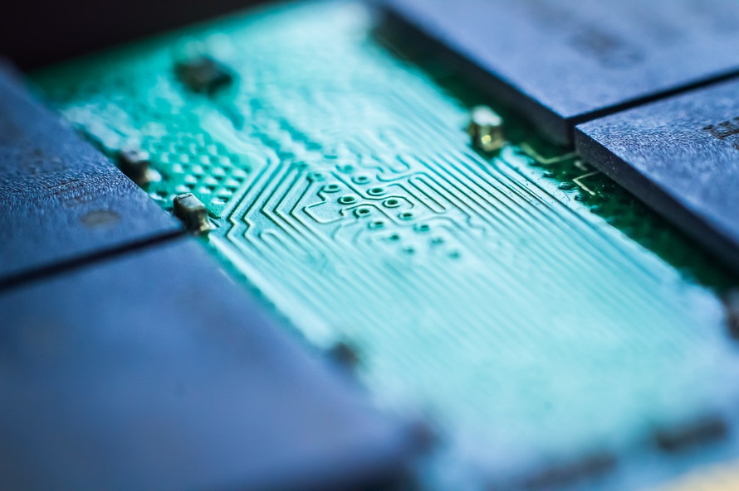
Feed the dog Applet

Slide 2
Problem to solve
We create this applet to avoid forgetting feeding the pet and also to know when he need some food
This is an applet create for our pets
Everywhere and every time your pet need some food, you receive a notification

Slide 3
Solution
We used the light sensor to indicate if the pet’s billy is empty. The billy need to be transparent. If the intensity of the light is up to 100 lux (this means the billy is nearly empty), the Sens’it detect the situation and via the IFTTT, we receive a notification on our smartphone to alert us of the billy’s capacity.

Slide 4
Strategy
TAM (total addressable market) : This is a huge market because every pets owner would need this application.
Money needs : Our application only needs a light sensor, the money need is very low. However, the user needs to have a smartphone.
This application could be operational very soon thanks to its simplicity of using and its low need of money.

Slide 5
شكرا
Aitäh
Děkuji
Obrigado
谢谢
Merci
Tack
Hvala
Gracias
Terima kasih
Thank you
Danke
ありがとう
Grazie
با تشکر از شما
Dankjewel
Dankie
고맙습니다
Tak
Nirringrazzjak
Kiitos
ขอบคุณ
Go raibh maith agat
Teşekkür ederim
iotagency@sigfox.com

